Slide 1
AI with Alexa
Prof. Anubha
Prof. Sherish

Slide 2
WHAT ALEXA CAN DO
Alexa is virtual assistant that you can talk to and ask for all kinds of things, whether it's information, entertainment, tasks, or controlling your smart home devices etc. all with just your voice.
Amazon is the primary company behind the development of Alexa and the Echo devices that house this virtual assistant. However, there are other companies that have developed their own voice assistants and smart speakers.
Amazon:
Virtual Assistant: Alexa
Smart Speaker: Amazon Echo
Google:
Virtual Assistant: Google Assistant
Smart Speaker: Google Home/Nest Audio
Apple:
Virtual Assistant: Siri
Smart Speaker: HomePod /HomePod mini
Microsoft:
Virtual Assistant: Cortana
Devices: Integration with Windows operating systems and third-party devices
Samsung:
Virtual Assistant: Bixby
Devices: Integration with Samsung smartphones, smart TVs, and home appliances

Slide 3

EXAMPLES
Getting Information: Alexa can tell you facts or trivia. For example:
You: "Alexa, tell me an interesting fact."
Alexa: "Did you know that the Eiffel Tower has 20,000 light bulbs?”
Playing Games: Alexa can play games with you. Here's an example:
You: "Alexa, let's play 20 Questions."
Alexa: Starts the game and asks you questions.
Setting Reminders: Alexa can help you remember things. Try this:
You: "Alexa, remind me to water the plants at 5 p.m."
Alexa: "I'll remind you to water the plants at 5 p.m.”
Getting Recipes: Alexa can help you cook. For instance:
You: "Alexa, how do I make chocolate chip cookies?"
Alexa: Reads out the recipe step-by-step.
Asking Questions: You can talk to Alexa just like talking to a friend.
For example:
You: "Alexa, what's the weather today?"
Alexa: "Today's weather is sunny with a high of 45 degrees.”
Playing Music: Alexa can play songs you like. For instance:
You: "Alexa, play 'Shape of You'."
Alexa: Starts playing the song.
Setting Alarms: Alexa can wake you up in the morning. Try this:
You: "Alexa, set an alarm for 7 a.m. tomorrow."
Alexa: "Alarm set for 7 a.m. tomorrow.”
Controlling Lights: If you have smart lights, Alexa can turn them on or off:
You: "Alexa, turn off the bedroom lights."
Alexa: The lights turn off.

Slide 4
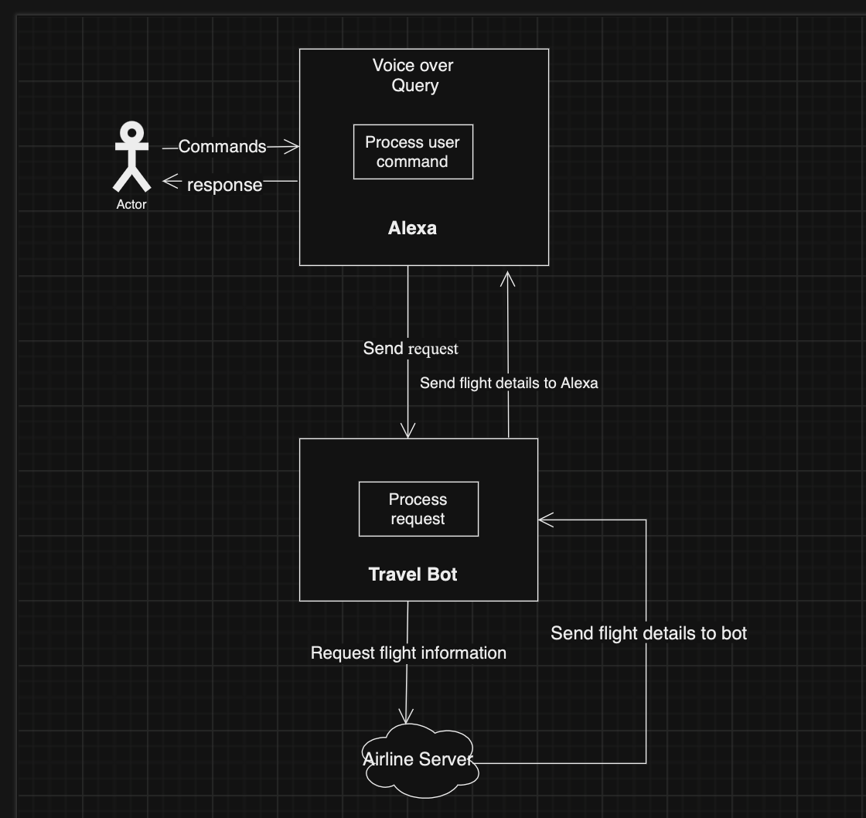
INTERACTION DIAGRAM
ALEXA | CHATBOTS
Voice Assistant | Text or Voice Helper
How Alexa works?
User: "Alexa, ask TravelBot for flight details.”
Alexa Skill: Alexa connects with TravelBot to retrieve flight information.
Response: Alexa then shares the flight details with the user

Slide 5
Interaction model
Alexa, tell Coffee Company I would like to have a latte.

Slide 6
Amazon Alexa Skill Set for Hello world
Set Up Alexa Skill in Developer Portal
Step 1: Create a New Skill
Log in to the Alexa Developer Console.
Click on Create Skill.
Enter the Skill Name as Welcome Class
Choose Custom for the interaction model.
Choose Alexa-hosted (Node.js) as the hosting method.
Click Create Skill.

Slide 7
Step 2: Set the Invocation Name
In the left navigation, go to Build > Interaction Model > Invocation.
Set the Skill Invocation Name to Welcome Alexa.
Click Save and Build Model.
2. Create Custom Intents and Slot Types
Step 3: Add Custom Intents
Navigate to Interaction Model > Intents.
Click Add Intent and then Create custom intent.
Add the WelcomeIntent
Name: WelcomeIntent

Slide 8
Step 4: Create Custom Slot Types
Go to Interaction Model > Slot Types.
Click Add Slot Type > Create custom slot type.
Create a custom slot for the type of greeting or task the user might want.
Create the GreetingType Slot
Name: GreetingType
Values: “friends”, ”team”,”students”

Slide 9
Add Slots to WelcomeIntent
After creating the custom slot type, go to the WelcomeIntent.
Add a slot under Slot Definitions:
Slot Name: greeting
Slot Type: GreetingType
Add the Sample Utterances for WelcomeIntent to include the slot:
”Hey{greeting}"
”Hello {greeting}"
3. Alexa Responses and Utterances
Alexa will respond to the custom utterances based on user input

Slide 10
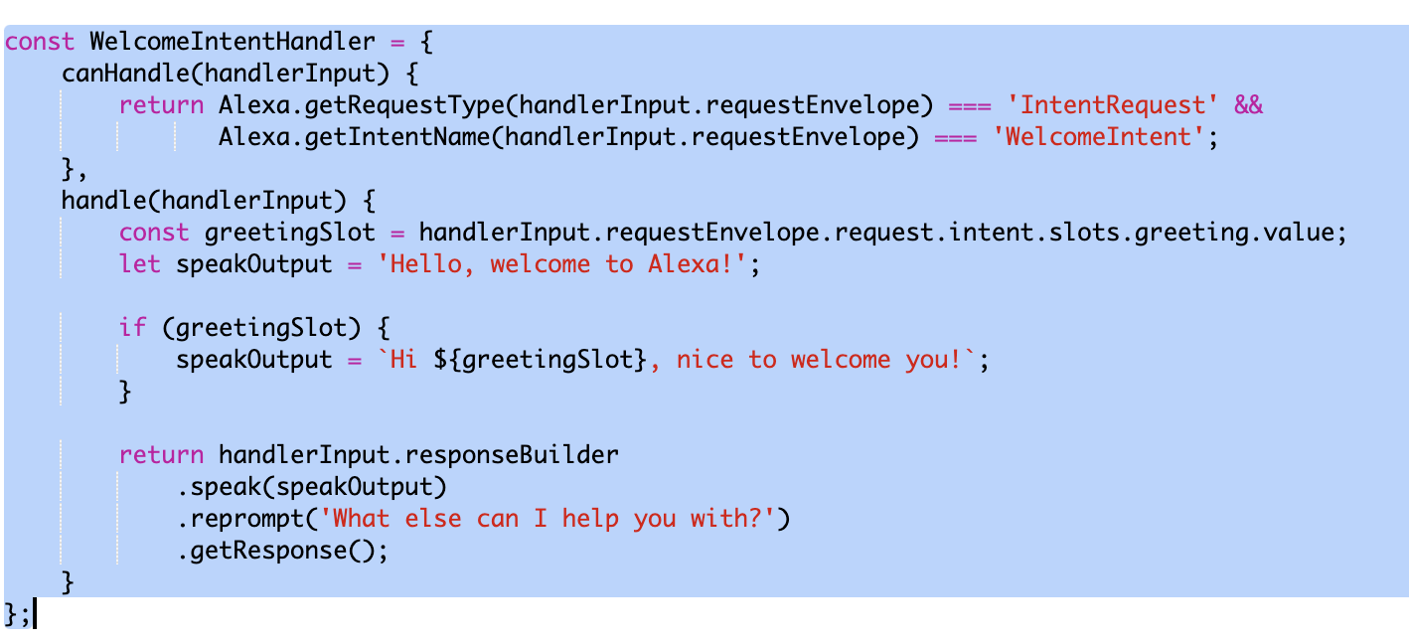
4. Node.js Code for Alexa Skill
Go to the Code tab in the Alexa Developer Console and replace the default code with the following Node.js code to handle the custom greeting slot and provide an appropriate response.

Slide 11
5. Test the Skill
Go to the Test tab in the Alexa Developer Console.
Set the skill to Development mode.
Test the skill using the following invocation phrases:
"Alexa, open Welcome Class
Hey team

Slide 12
Thank You

